Slide 1
QUANTUM AGE
ASTRAKHANTSEV ROMAN

Slide 2
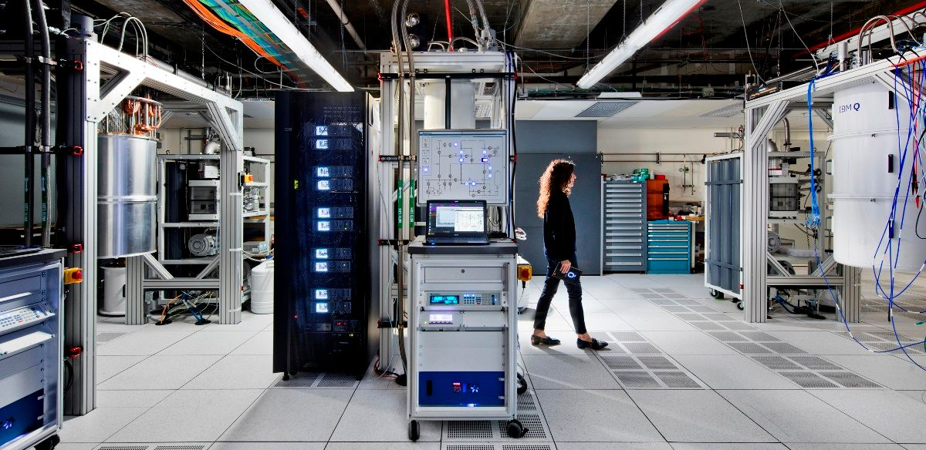
WHAT IS IT?

Slide 3
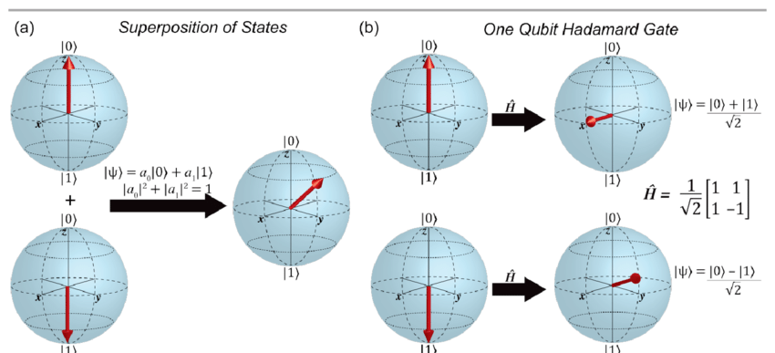
HOW IT WORKS?

Slide 4

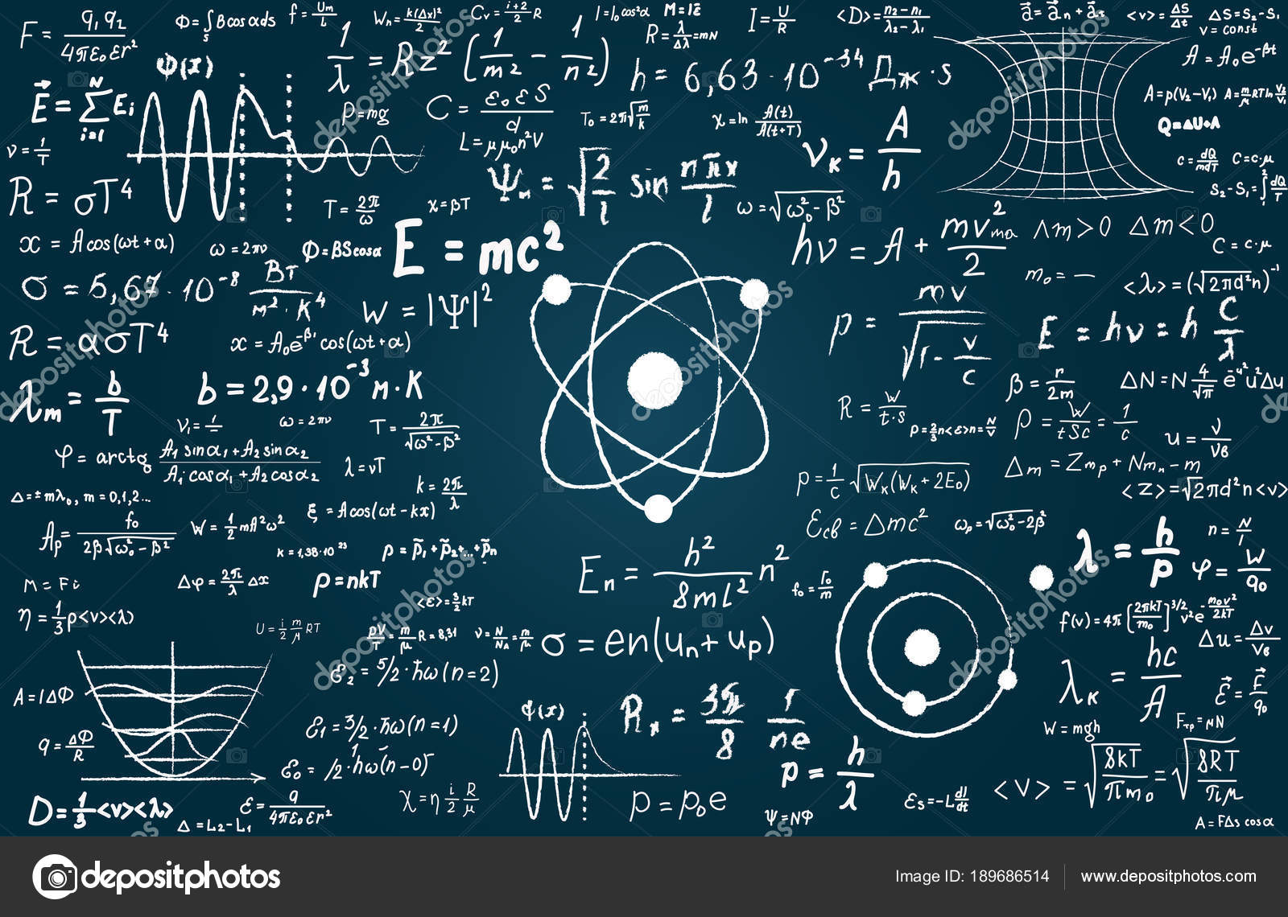
What are the benefits?
N qubits = 2^N computer bits

Slide 5
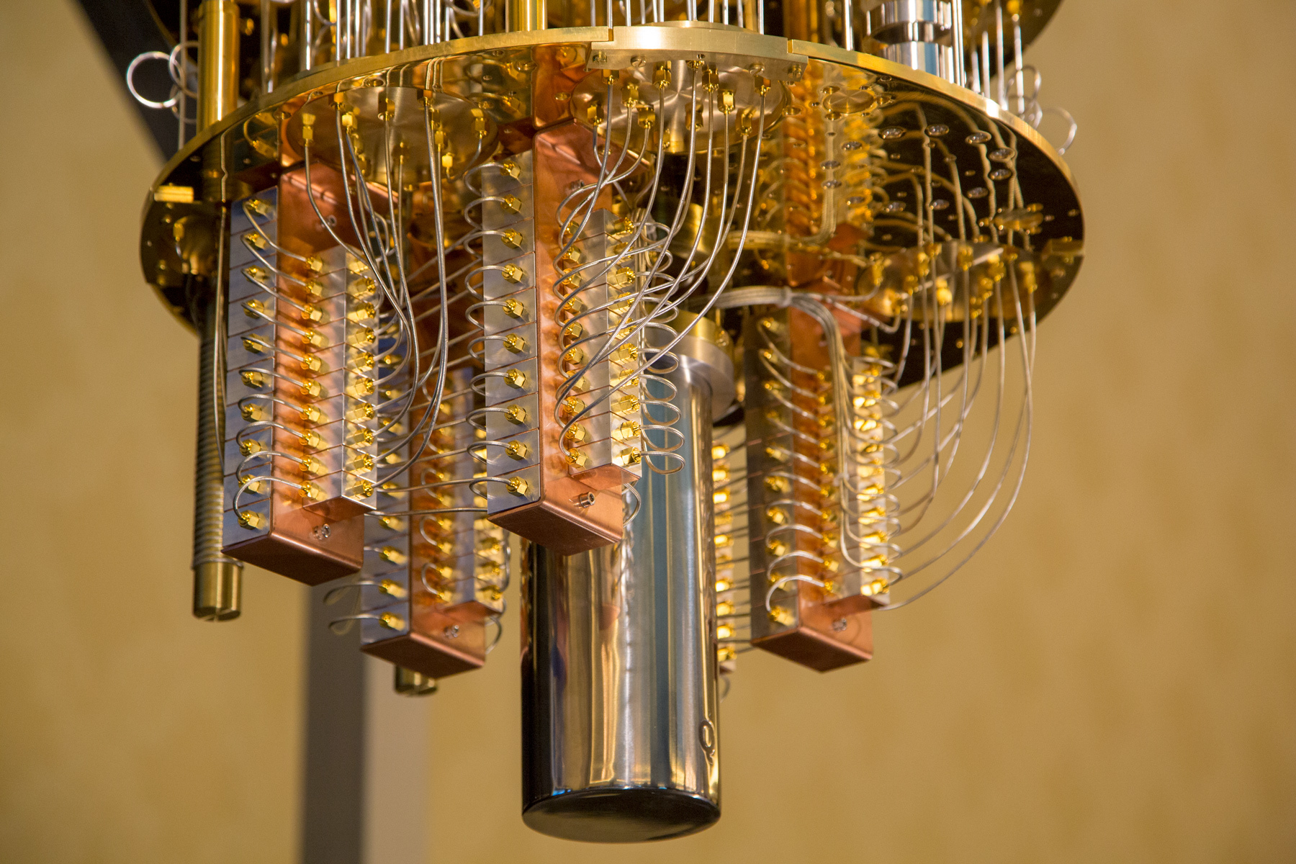
How it looks?

Slide 6
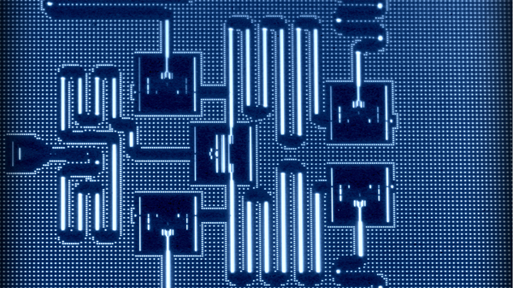
Problems: Noise

Slide 7
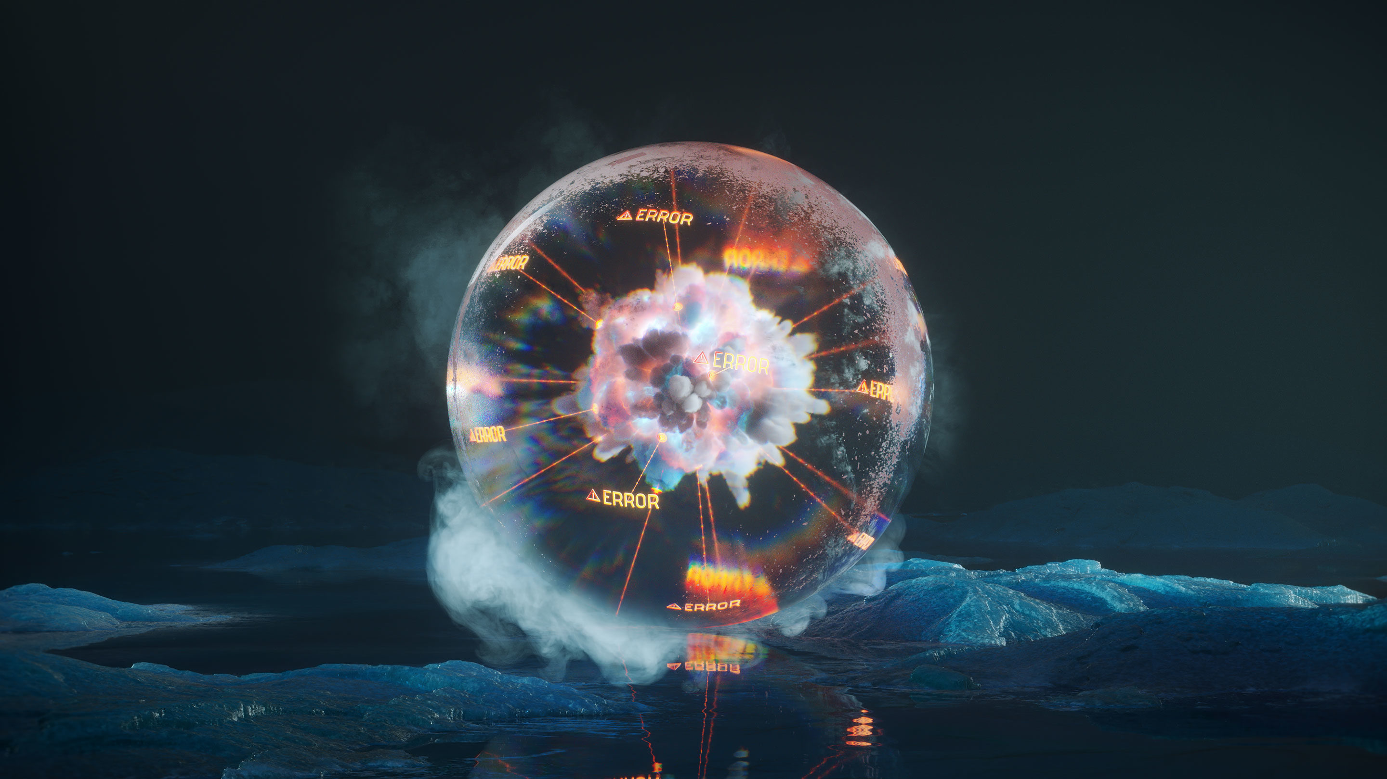
Problems: errors

Slide 8
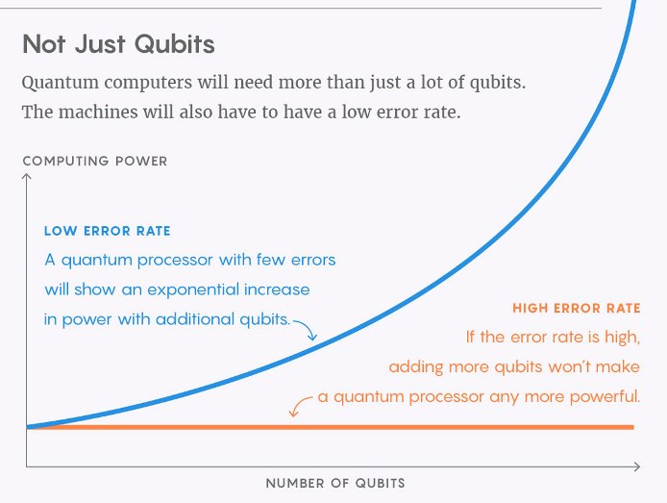
Fixing ERRORS DOES NOT WORK ☹

Slide 9

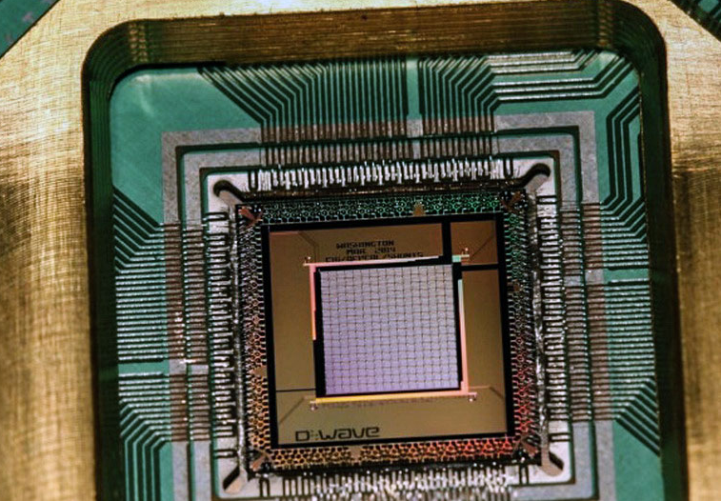
The conclusion
NICE CONSEPTION

